Slide 1
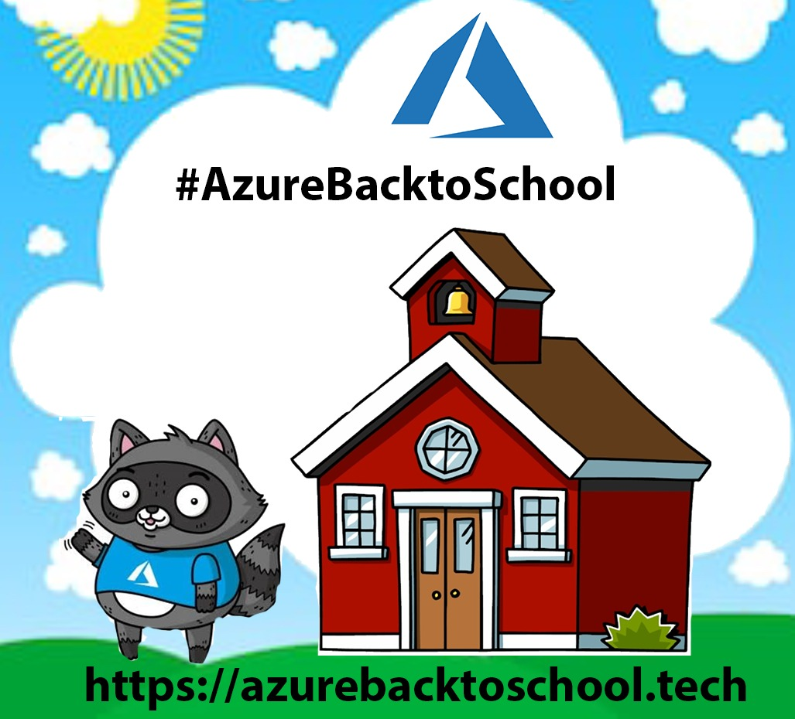
From Zero to GitOps with AKS
Thomas Thornton
Karl Cooke

Slide 2

Speaker Intro – Thomas Thornton
Azure MVP & Microsoft Certified Trainer
Azure Technical Specialist – Kainos in Belfast
Azure Certified
Azure Solutions Architect
DevOps Engineer
Azure Security Engineer
Azure Administrator
https://thomasthornton.cloud/
Twitter:- https://twitter.com/tamstar1234

Slide 3

Speaker Intro – Karl Cooke
Azure Consultant – Intercept B.V.
Azure Certified
DevOps Engineer
Azure Security Engineer
Azure Administrator
https://irishtechie.cloud
Twitter:- https://twitter.com/Karl_ITNerd
Co-organizer @ Limerick DotNet Azure User Group

Slide 4
Agenda
What is AKS?
Azure AKS Architecture
Nodes and Node Pools
Benefits of AKS
GitOps
GitOps Tooling
Fluxv2
Terraform
Azure Pipelines
Demos!
Wrap-up/Key Takeaways

Slide 5
What is AKS?
Azure Kubernetes Service (AKS) is a managed Kubernetes service
Kubernetes Master nodes (control plane) are managed by Azure
You only need to concentrate on the worker nodes

Slide 6
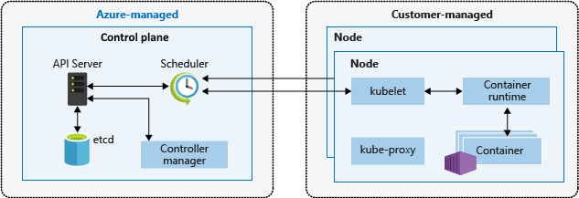
Azure AKS Architecture
Image Reference: docs.microsoft.com

Slide 7
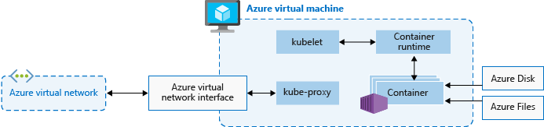
Nodes and Node Pools
Image Reference: docs.microsoft.com

Slide 8
Benefits of AKS
Scalability (Add additional compute if/when needed)
No need to worry about master nodes or the backend infrastructure
Reduces the initial setup and operational complexity of Kubernetes for Production workloads
Keeping containerized apps up and running, can be complex – let AKS assist you!

Slide 9
GitOps
GitOps is a process that leverages the Git developer toolset for operations and management of cloud-native applications © rancher.com
GitOps in Kubernetes places the cluster into a desired state
Version Control with GitOps
The only components that are deployed on the cluster is from version control
Ensures what is deployed onto the clusters are correct

Slide 10
GitOps Tooling
GitOps Builds on immuatable infrastructure
Numerous tools are available to help you implement GitOps
In our demo, we will be using Fluxv2
Flux is a tool for keeping Kubernetes clusters in sync with sources of configuration (like Git repositories) and automating updates to configuration when there is new code to deploy.

Slide 11
Flux2
5 main components make up Flux2
Source Controller
Kustomize Controller
Helm Controller
Notification Controller
Image Automation Controllers

Slide 12
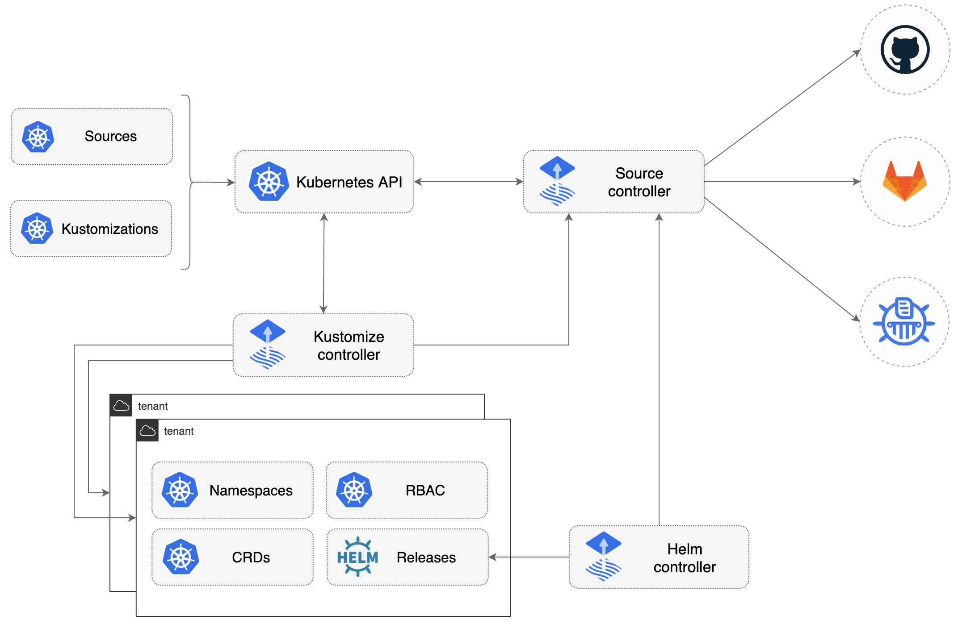
Fluxv2 – Source Controller
Image Reference: https://github.com/fluxcd/flux2

Slide 13
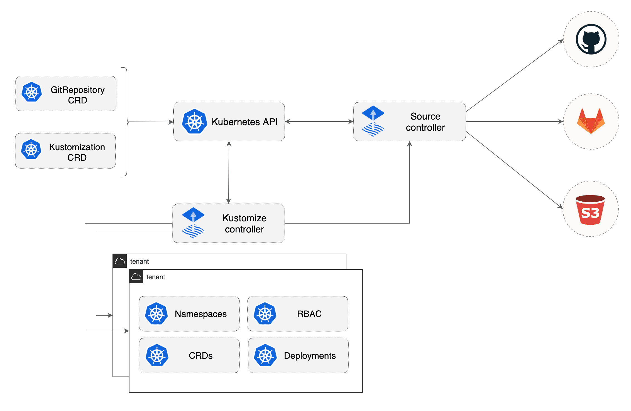
Fluxv2 – Kustomize Controller
Image Reference: https://github.com/fluxcd/flux2

Slide 14
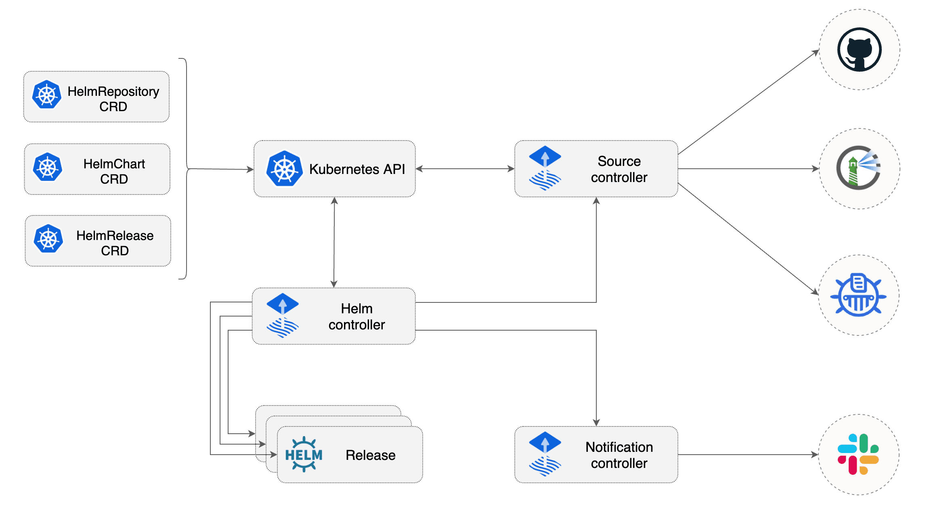
Fluxv2 – Helm Controller
Image Reference: https://github.com/fluxcd/flux2

Slide 15
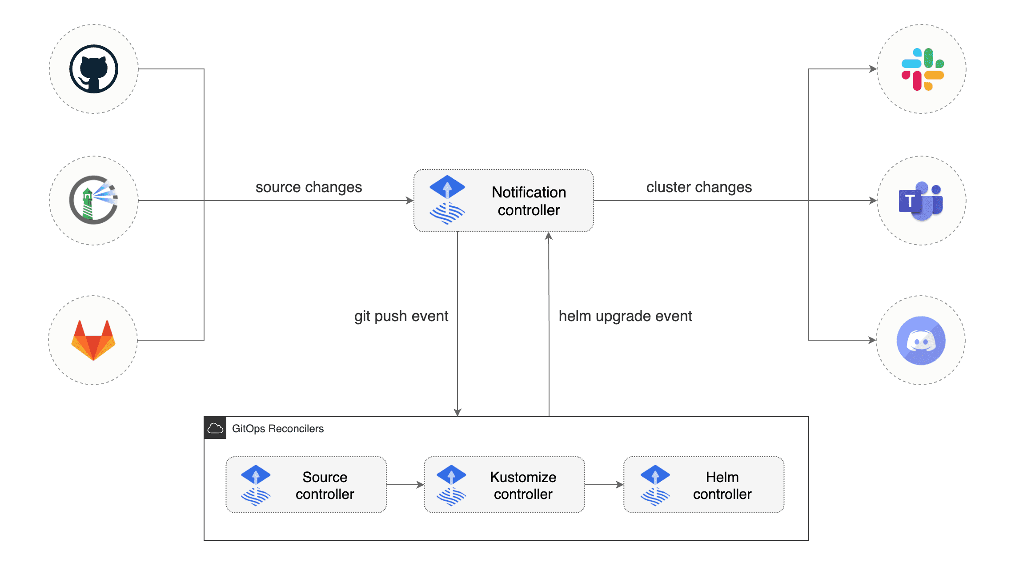
Fluxv2 – Notification Controller
Image Reference: https://github.com/fluxcd/flux2

Slide 16
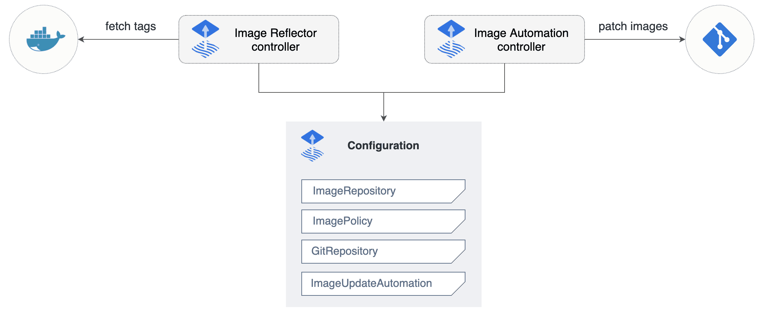
Fluxv2 – Image Automation
Image Reference: https://github.com/fluxcd/flux2

Slide 17
Deploying AKS using Azure DevOps and Terraform
Deploy initial Infrastructure for AKS
Terraform deploys the infrastructure into Azure
Deployed using Azure DevOps Pipelines

Slide 18
A way to manage Azure
Easy to read and write
Declarative
Driven via the Azure API
OpenSource Free
Disposable Environments
Lowers the potential for human errors while deploying and managing infrastructure.
What is Terraform?

Slide 19
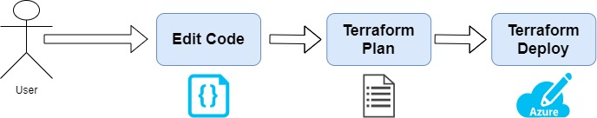
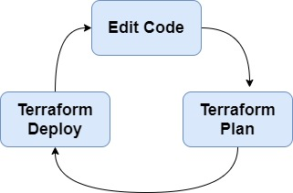
Terraform Workflow
Terraform Workflow
terraform init - Initialize a Terraform working directory
terraform plan - Generate and show an execution plan
terraform apply - Builds or changes infrastructure
terraform output - Read an output from a state file
terraform destroy - Destroy Terraform-managed infrastructure

Slide 20
Terraform Teminology
Providers represent a cloud provider or a local provider
Resources can be invoked to create/update infrastructure locally or on the cloud.
State is representation of the infrastructure created/updated by terraform.
Data Sources are “read-only” resources

Slide 21
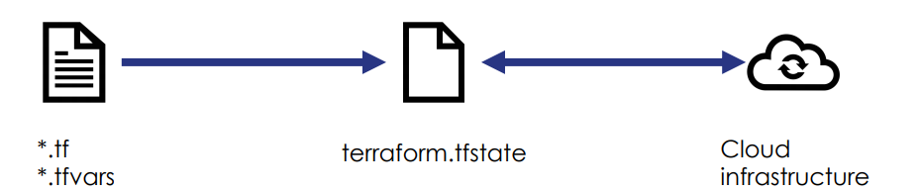
Terraform State
Terraform must store state about your managed infrastructure and configuration.
This state is used by Terraform to map real world resources to your configuration, keep track of metadata, and to improve performance for large infrastructures.
This state is stored by default in a local file named "terraform.tfstate", but it can also be stored remotely, which works better in a team environment.

Slide 22
Azure Pipelines is a cloud service that you can use to automatically build and test your code project and make it available to other users. It works with just about any language or project type.
Azure Pipelines combines continuous integration (CI) and continuous delivery (CD) to constantly and consistently test and build your code and ship it to any target.
Within our environment, we will be using Azure Pipelines to deploy our Terraform code
You define pipelines using the YAML syntax or through the Azure DevOps portal – we will be using YAML
Azure Pipelines

Slide 23
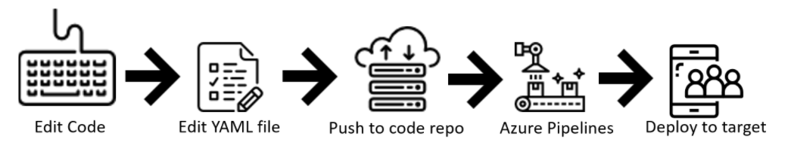
Azure Pipelines via Code
You define your pipeline in a YAML file within your repo, azure-pipelines.yml for example
The YAML pipeline is versioned the same way as your Terraform code.
It will follow the same branching structure allowing you to have a pull-request process for any changes to any Pipelines that you may make
Will look at some cool pipeline/repo additions

Slide 24
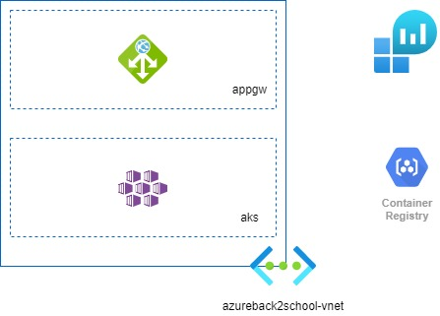
The GitOps Journey…the beginning.

Slide 25
Demo Time

Slide 26
Demo Time – what did we cover?
Azure Pipeline Deployment (Using Templates)
Bootstrapping AKS Cluster
GitOps
Updating images via GitOps

Slide 27
Key Takeaways
Terraform is readable and quite user friendly
The beginning of CI/CD deployments
Intro to GitOps
Test outside of your pipeline
GitOps & Immutable Infrastructure is awesome!
The urge to see even more of Azure, DevOps & GitOps! ☺

Slide 28
Recommended blog posts
Deploy Terraform using Azure DevOps https://thomasthornton.cloud/2020/07/08/deploy-terraform-using-azure-devops/
1
Creating Templates in Azure DevOps Pipelines https://thomasthornton.cloud/2021/08/16/creating-templates-in-azure-devops-pipelines/
2
Flux2 https://github.com/fluxcd/flux2
3
GitOps for Azure Kubernetes Service https://docs.microsoft.com/en-us/azure/architecture/example-scenario/gitops-aks/gitops-blueprint-aks
4
GitHub for Flux2
https://github.com/thomast1906/azure-back-to-school-2021-flux
5
GitHub for demo files /slides https://github.com/thomast1906/azure-back-to-school-2021
6

Slide 29
Community Resources
https://azurebacktoschool.github.io/
Azure Blog’s
YouTube
User Groups & Virtual Conferences
GitHub Resources
CloudFamily.info #cloudfamily
Community #azurefamily

